Slide 1
Business Analysis Projects

Slide 2
Projects Categories
Planning and Demand Forecasting
Monitoring
Reporting
Documentation
Others

Slide 3
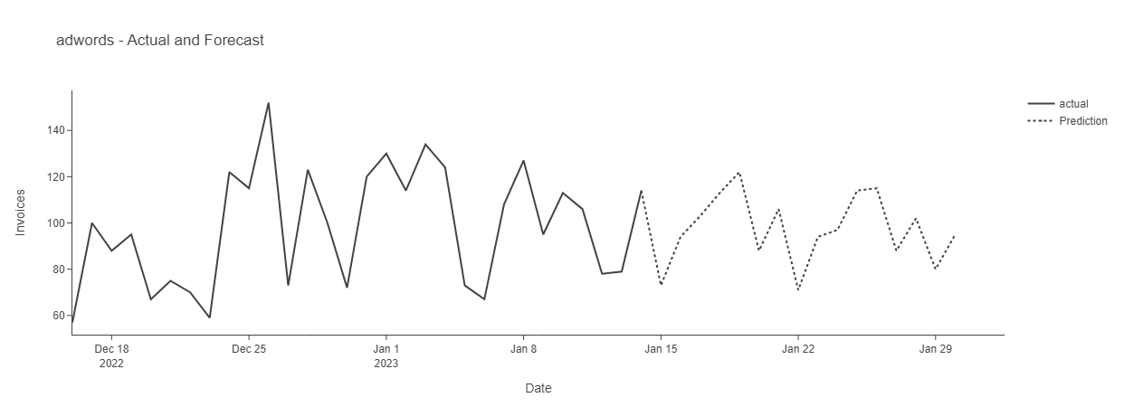
Planning and Demand Forecasting
Plans for T1 - 2023:
Development of a comprehensive data product model for planning targets.
Defining inputs:
Market size time series
Google trend for general keyword time series
Historical sales trend time series
Holidays
Training the model
Developing a ML product
Plans of T2 - 2023:
Optimizing and improving the model

Slide 4
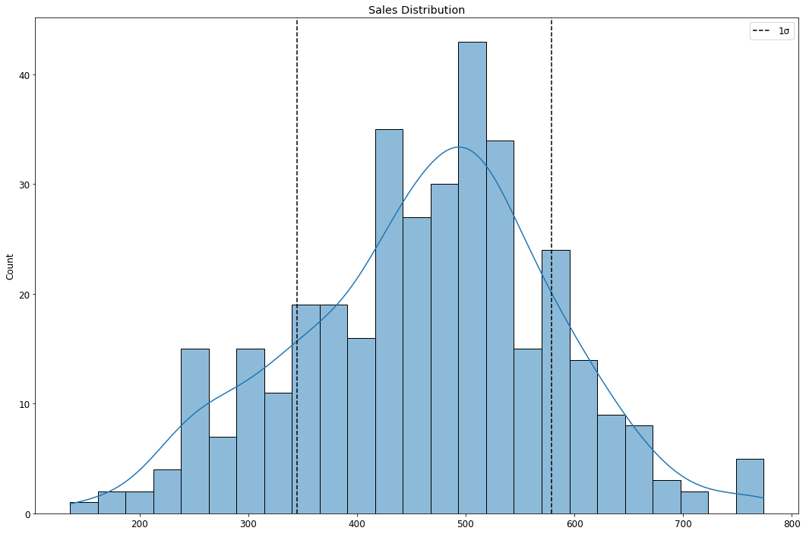
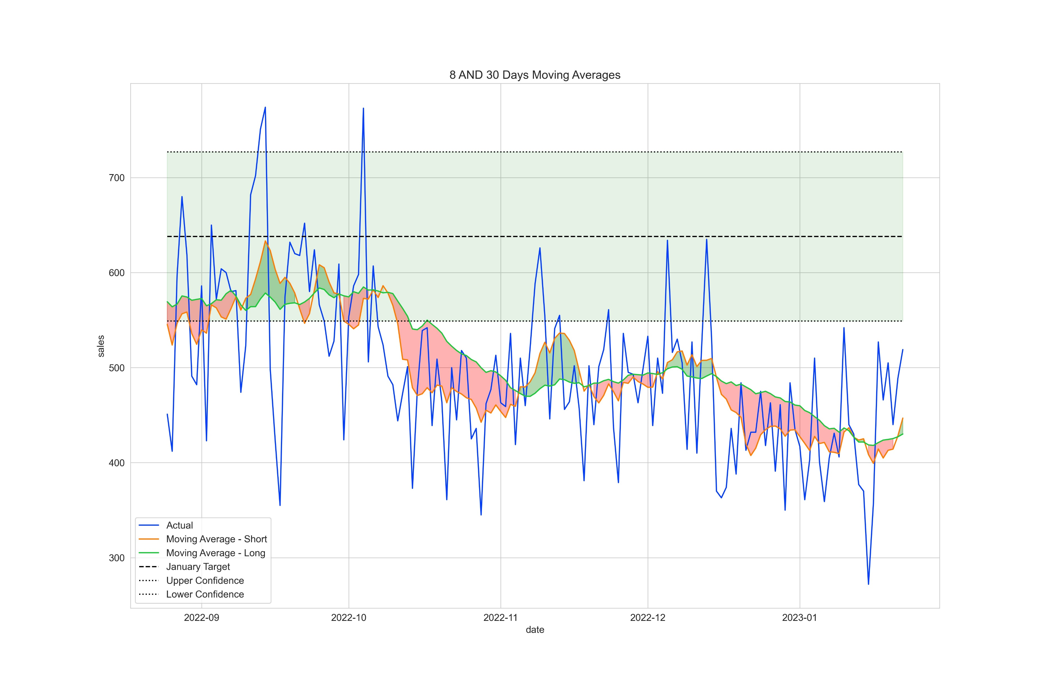
Monitoring
Three Types:
Live performance
Short-term performance
Long-term performance
Steps:
Anomaly detection
Health of trend evaluation
Performance Vs Target

Slide 5
Reporting
Plans for T1 - 2023:
A review of all daily reports, automate, and integrate them for business purposes (Concept in this Trimester)
A review of all weekly reports, automate, and integrate them for business purposes (Concept in this Trimester)
Finalizing monthly report (presenting the template and data product, collecting feedback of the business, revising and publishing)
Plans of T2 - 2023:
Finalizing integrated daily reports
Finalizing integrated weekly reports

Slide 6
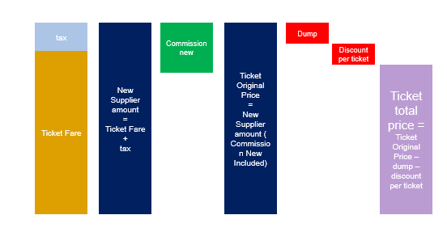
Documentation
Plans for T1 - 2023:
Finalizing documentation for domestic flight
Detailed descriptions of Metabase fields for all verticals : signed off from finance on calculations and agreement with Commercial and other involved departments on descriptions.
Starting documentation for International Flight
Plans of T2 - 2023:
Starting documentation for other verticals

Slide 7
Others
Increasing revenue by detailed users segmentation
CS data and ETA on customers comments

